Slide 1

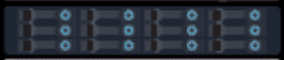
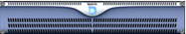
10 TB
Mgmt switch
App nodes
6U
Data switch
Data node

Slide 2
10 TB
Mgmt switch
6U
App nodes
Data switch
Data node

